Slide 1
Threading Part 2
CS221 – 4/22/09

Slide 2
Where We Left Off
Simple Threads Program:
Start a worker thread from the Main thread
Worker thread prints messages for a period of time
If it takes too long the Main thread will interrupt it
Uses:
Thread.start
Thread.sleep
Thread.join
Thread.isAlive
Thread.interrupt

Slide 3
Thread Communication
Threads communicate through shared memory
You can share across threads anything that you could share within a single thread:
Object instances
Fields and methods on objects
Etc
Special communication actions can be accomplished via the Thread object
Join, sleep, interrupt, etc.

Slide 4
Thread Communication
The good:
It is very efficient
The bad:
Thread interference
Memory consistency problems

Slide 5
Thread Interference
Interference occurs when two threads modify the same data at the same time
If operations interleave, rather than completing atomically, you have a problem

Slide 6
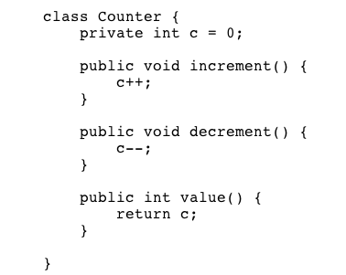
Example

Slide 7
Example
Increment can be decomposed into atomic operations:
Retrieve C
Increment C by 1
Store the new value into C
Decrement
Retrieve C
Decrement C by 1
Store the new value into C

Slide 8
Example
Imagine:
Thread 1 calls increment
Thread 2 calls decrement
What will happen?

Slide 9
Example
Hard to say actually!
Here is one possibility:
Thread 1: Retrieve C
Thread 2: Retrieve C
Thread 1: Increment stored value (0->1)
Thread 2: Decrement stored value (0->-1)
Thread 1: Store value into C (C=1)
Thread 2: Store value into C (C=-1)

Slide 10
Example
This interleaving of operations results in the value of Thread 1’s operations being overwritten
Order of execution could be different every time:
Thread 1’s value is overwritten
Thread 2’s value is overwritten
No error

Slide 11
Example

Slide 12
Memory Consistency Errors
Results when two threads have inconsistent views of the same data
Can happen even if you solve the previous problem and ensure the writes are atomic
If Thread 1 modifies data and Thread 2 reads that data, it may not yet be committed to memory
Thread 2 may get the old value…

Slide 13
Example
Counter is initialized:
int counter = 0;
First, Thread 1:
Counter++;
Next, Thread 2:
System.out.println(counter);
We know that (counter == 1) is true for Thread 1
We cannot guarantee that (counter == 1) is true for Thread 2

Slide 14
Scary!
How do we solve these problems?
Thread Synchronization!
Some we already know:
Thread.start: Guarantees all actions performed by the originating thread are synchronized to the new thread.
Thread.join: When a join returns due to termination, all actions from that thread are synchronized to the originating thread.

Slide 15
Thread Synchronization
Thread synchronization is -
Coordinating simultaneous threads so that you:
Guarantee the correct runtime order of operations
Avoid race conditions which could result in thread interference or memory consistency problems

Slide 16
Thread Synchronization
How do you do accomplish thread synchronization?
Data integrity options:
Synchronized methods
Synchronized statements using locks
Atomic data access
Immutable objects
Order of operations options:
Guarded blocks
Locks

Slide 17
Synchronized Methods
It is impossible for two threads to interleave on a synchronized method
While Thread 1 is in the method, Thread 2 is blocked
Guarantees memory consistency
When Thread 1 exits the method, Thread 2 is guaranteed to see the same data

Slide 18
Synchronized Methods
If a method can be called by two threads…
…Use synchronize keyword to ensure data integrity within that method
public synchronized void decrement()

Slide 19
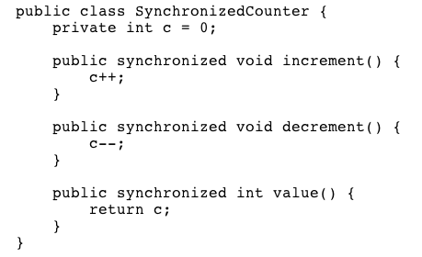
Example

Slide 20
Intrinsic Locks
Every object is associated with an intrinsic lock
In order for a thread to get exclusive access to an object, it must:
Acquire the lock before access
Release the lock when it is done
When a thread acquires a lock, no other thread can acquire the same lock
Synchronized methods do a lot behind the scenes:
Thread 1 acquires lock for the Counter object
Thread 1 calls increment method()
Thread 2 tries to acquire the lock
Thread 2 blocks
Thread 1 releases the lock
Thread 2 acquires lock for the Counter object
Thread 2 calls decrement() method

Slide 21
Synchronized Statements
Blocking on an entire object can cause performance problems
Synchronized statements give you more control over the acquisition and release of locks
Much easier to make a mistake – be careful!

Slide 22
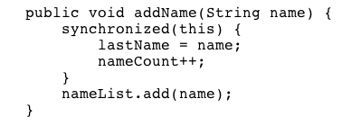
Example 1

Slide 23
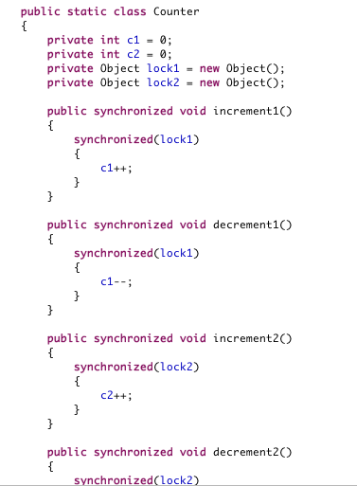
Example 2

Slide 24
Atomic Data Access
Atomic Action: An action that is indivisible and cannot be interrupted until it is complete.
Is counter ++; atomic?
How do you ensure an action is atomic?

Slide 25
Volatile Keyword
The volatile keyword ensures that all access to a variable will be atomic
private volatile int c = 0;
Volatile keyword tells Java that this variable will be accessed by multiple threads

Slide 26
Volatile
What it gives you:
Ensures memory consistency
Ensures atomic read operations on the variable
Ensures atomic write operations on the variable
What it does not give you:
Read+Update+Write is still not atomic
What does this mean?

Slide 27
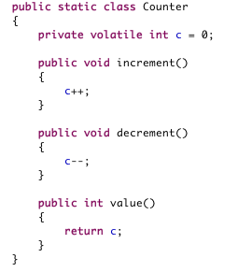
Example

Slide 28
Volatile
When should volatile be used?
You write a variable in one thread
You check it in another
Typical scenario:
You have a boolean flag that two threads can access
Thread 1 sets the value to true
Thread 2 checks to see if the value is true before taking some action

Slide 29
